Slide 1
A Gentle (Re-)Introduction to Dimensional Modeling
SQL Saturday Houston
June 27th, 2026

Slide 2


He / him pronouns
Microsoft Data Platform MVP
MCSE: Data Management and Analytics
Albuquerque data platform group leader
Contact me:
Bluesky: @chrishyde325.bsky.social
Email: chrishyde325@gmail.com
Chris Hyde
Owner and Principal Consultant
Hydrate Consulting, LLC
@chrishyde325.bsky.social

Slide 3
agenda, part 1
What is dimensional modeling and why does it matter?
Fact tables
Dimension tables
Star schema
Snowflake schema
The Kimball methodology

Slide 4
agenda, part 2
My table and schema design patterns
Why I like views
Let's talk about nulls
Sentinel values
Plumbing, miscellaneous, and the dreaded customer
dimension
Exercise!

Slide 5
what is dimensional modeling?
Dimensional modeling is a pattern and approach to modeling
data specifically to support analytical workloads (OLAP)
First published by Kimball in 1996 in The Data Warehouse
Toolkit based on his practices in the early and mid 1990s
Data is organized into fact and dimension tables that are
arranged in patterns called star schemas (hooray!) or
snowflakes (boo, hiss)

Slide 6
why does dimensional modeling matter?
Tables are optimized for analytical workloads, ie. Querying
rather than for frequent transactions
Tables are organized and named in a business-focused manner
Much easier for data analysts to query
So easy, even BI tools can do it!
Predictable patterns reduce development time, both for
queries and for the transformation layer
The foundation of every successful data warehousing
project!

Slide 7
fact tables
Facts are the events or measurements that you will be
aggregating
A fact table contains mostly numeric, additive values
referred to as "measures"
The "grain" of a fact table refers to the level of detail
captured, ie. what does one row represent
The grain is most often a specific event such as a sale, an
appointment, a transaction etc., but sometimes summary
fact tables will be created
Usually the largest tables in your presentation layer
Business users often think of facts as the "data" tables

Slide 8
dimension tables
Dimensions are the context in which the aggregations are
viewed
The who, what, where, when, and maybe even the why
A dimension table contains mostly descriptive columns
referred to as "attributes"
In general, attributes are one-to-one with the "member" of
the entity they represent, eg. a Person has a Name, a Product
has a Category, an Employee has a department
Fact tables contain the measures that you aggregate ie.
SUM(), MIN(), AVG(), etc.; Dimension tables contain the
GROUP BY, WHERE clauses
Business users often think of dimensions as "lookup" tables

Slide 9
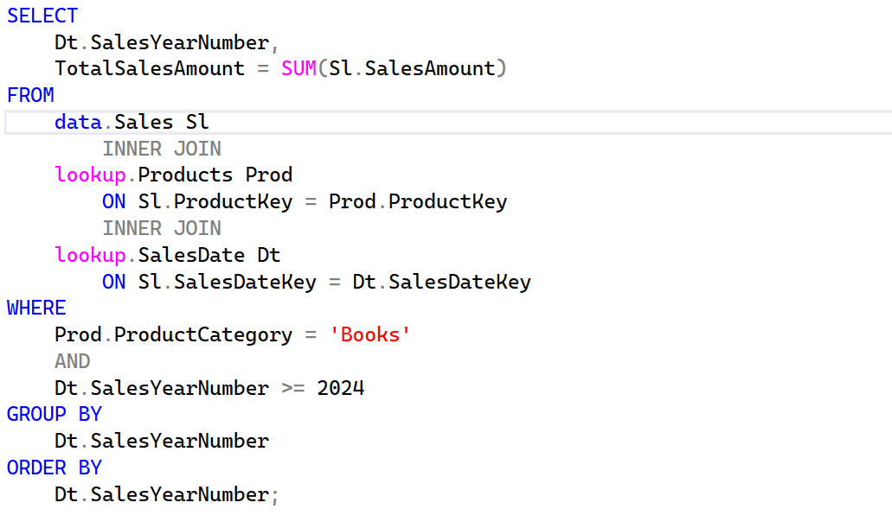
facts and dimensions example query

Slide 10
star schemas
Star schemas have a single fact table at the center
Dimension tables radiate outward, forming a star shape
Foreign key fields relate the dimension tables to the fact
table (well, usually)
Note that this is deliberately denormalised for ease and
speed of querying

Slide 11
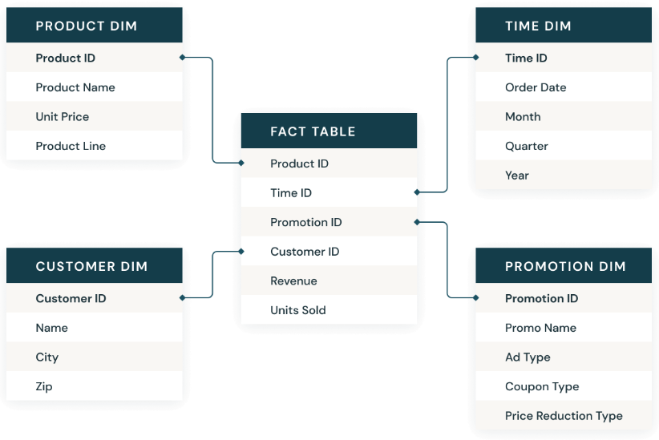
star schema example

Slide 12

snowflakes
Still a single fact table, but dimensions are normalised
For example: product name → product sub-category → product category
Saves on storage, but queries are more complex
When to use: NEVER
Okay, that's not true. This can sometimes be helpful with very large dimensions with clear hierarchies.
Microsoft recommends using star schemas in Fabric due to how the query
engine is optimised

Slide 13
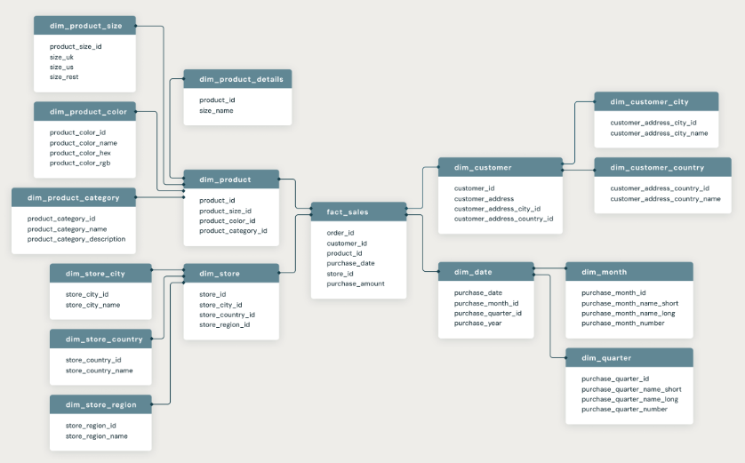
snowflake example

Slide 14
the Kimball modeling methodology
So simple, anyone can do it!
1. Identify the business process to model
2. Decide on the grain of the fact table
3. Choose the dimensions that will apply to each row in the fact table
4. Identify the numeric measures that will be populated in each row in the fact table

Slide 15
conforming dimension tables
Many common dimension tables are often "conformed," meaning the contexts are standardized across many facts
The mapping and decision-making to make this happen can be very painful
But it is crucial as it's nigh-on impossible to perform analysis across different systems if, say, the department structure is different in each one

Slide 16
common dimension tables
Many of the most common dimension tables are conformed by their very nature
A calendar or date table is the most common dimension table, and often has to be created from scratch
Customer, Department, Employee, Geography, Location, Product, Status, etc.

Slide 17
dr. jekyll's dimension design
Start with a surrogate key (SMALLINT, INT, or BIGINT) called <table_name>Key as a unique primary key
Add a column for the data value that best identifies the member of the dimension, ie. PatientName
Add columns for any hierarchies in order of largest (least granular) to smallest (most granular)
Add the remaining columns, preferably in alphabetical order, and use nulls only if your life depends on it
Then add your plumbing

Slide 18
i can design facts too!
Start with a surrogate key (INT or BIGINT) called <table_name>Key as a unique primary key
Add "foreign keys" to each related dimension called <dimension_name>Key
Don't forget to match data types and remember role-playing dimensions!
Add the measures, preferably in alphabetical order
Include numerator and denominator measures if you have division coming up later
Push calculations upstream as far as possible!
Then add your plumbing

Slide 19
plumbing
For both fact and dimension tables include the following fields:
Which source system did your row come from? <table_name>SourceSystemName
How was it identified in that source system, ie. what was the business key? <table_name>SourceSystemKey
When did this row last get updated in the warehouse? <table_name>LastUpdatedDateTime
More plumbing for dimensions only in a little bit...

Slide 20
schema usage at the presentation layer
fact for fact tables; dim for dimension tables
etl for integration tables, eg. intermediate transformations
But our end users, whether human or BI tools actually use views on top of those tables
data for fact table views; lookup for dimension views

Slide 21
why use views
Business users think in data and lookup, not fact and dim
Business users don't need or want to see the "plumbing" fields in our tables
Views handle "role-playing dimensions" neatly and help avoid ambiguity
Role-playing dimensions are when one dimension table can be used in multiple contexts in the same fact
Employee dimension could be used as employee, manager, legal partner, etc.
Calendar (date) dimension is often used many times
So many times...

Slide 22
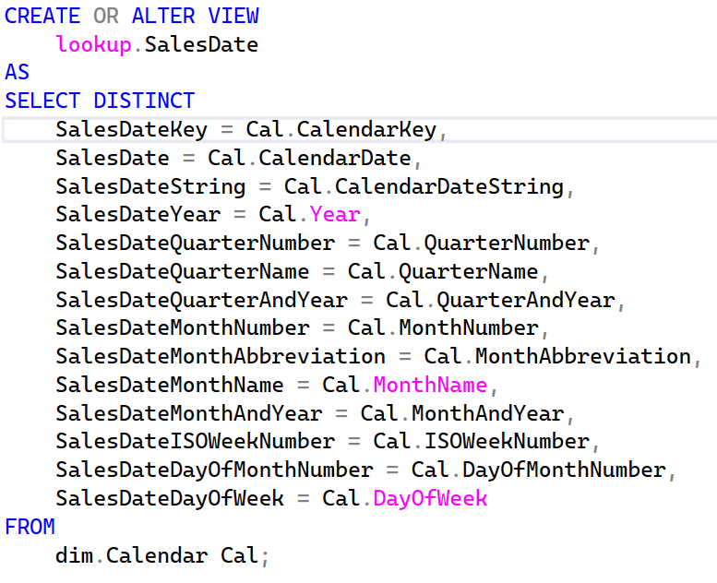
define the SalesDate view

Slide 23
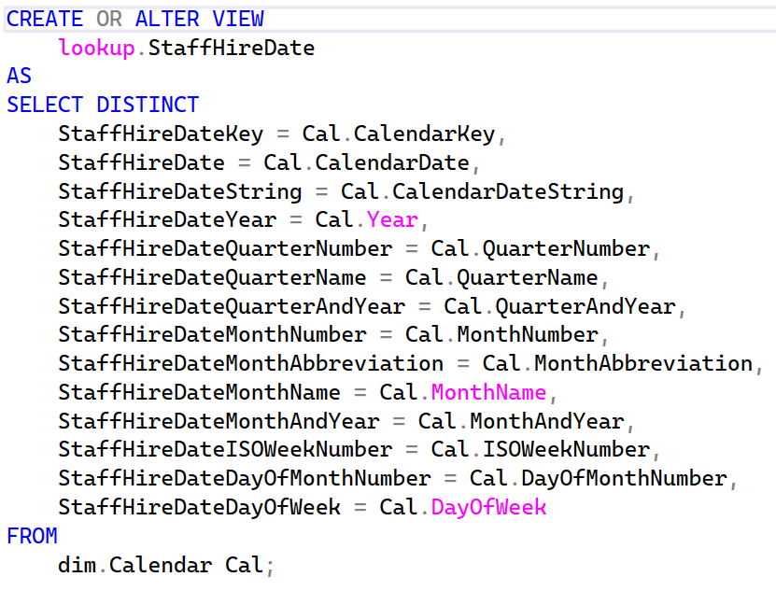
define the StaffHireDate view

Slide 24
return of the example query

Slide 25
let's talk about nulls
Only use nulls when necessary
They are the bane of human- and tool-written queries alike
Foreign keys in the fact table must never be null
Use empty strings for all character attributes
Only use nulls in dates and numeric fields, and only if you know they
actually are sometimes null

Slide 26
sentinel values, part 1
How can my foreign keys not be nulls if the data doesn't exist?
We add "dummy" rows to the dimension tables, with a negative surrogate key
Row key -1 is for <unknown> or <missing> data
Row key -2 is for <n/a> data
For example, a doctor's appointment that went ahead as scheduled would have -2 for CancelledDateKey

Slide 27
sentinel values, part 2
Row key -3 is for lagging data
For example, every course registration should have a student, so -1 if there is no matching student
Every course registration should have a grade after the term ends, so -1 after the term, but -3 before grades are given as we wouldn't expect a grade yet
Row key -4 and -5 for before and after specific events, eg. we tracked departments differently in our old system than we do in our new system
You've gone too far, this time! I usually use -1 for unknown/missing and
-2 for n/a and lagging combined

Slide 28
for the more discerning user...
Degenerate dimensions
Junk dimensions

Slide 29
the curse of the customer dimension
The customer is invariably the trickiest dimension, cf. patient, student, etc.
Every department defines customer differently, and usually each definition is so ingrained to that department that they don't realize it
So we almost always need both a customer dimension and a customer fact (watch out for key naming)
In fact (pun not intended), we should always query the warehouse starting with a fact and only then adding context.

Slide 30
Slowly Changing Dimensions (SCD)
Dimensions change over time: customers move, products get recategorized, employees change roles
SCDs are patterns for handling these changes
Named "slowly" because changes are infrequent compared to transactions
The type you choose affects what questions you can answer

Slide 31
type 0 SCDs
Something that will never ever change
Example: May 7th 2026 will always be a Thursday

Slide 32
type 1 SCDs
Simply update the existing record
No history preserved
Use when: History doesn't matter, corrections only
Example: Fixing a typo in customer name
Pros: Simple, no table growth
Cons: Can't answer "what was it before?"

Slide 33
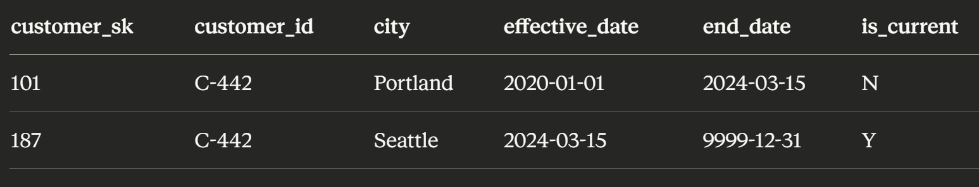
type 2 SCDs
Insert new row with new surrogate key
Mark old row as inactive (end date or current flag)
Use when: Historical accuracy matters
Example: Customer changes address, need to know where they lived when they ordered
Pros: Full history preserved
Cons: Table grows, queries more complex
Notes:
DO NOT HAVE END DATE = THE NEW EFFECTIVE DATE like in the Learn example above. This is a recipe for disaster.

Slide 34
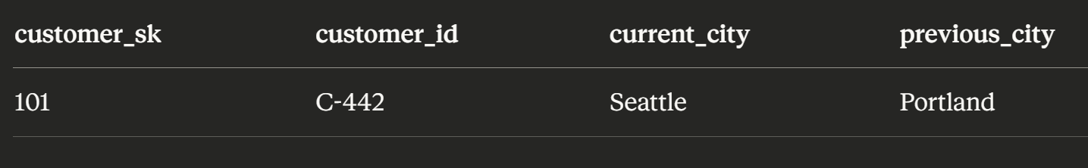
type 3 SCDs
Add column for previous value
Only tracks one change
Use when: Only need current and immediately prior value
Example: Current and previous account manager
Pros: Simple queries, no row growth
Cons: Limited history (only one previous value)

Slide 35
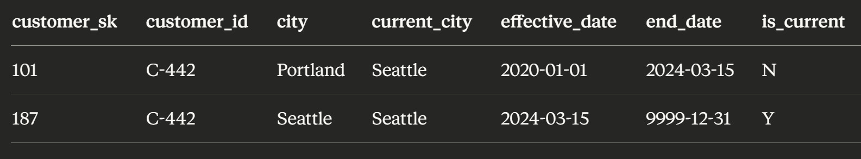
type 6 – Hybrid (1+2+3)
Combines approaches: new rows AND current value column
Both historical and current values easily accessible
Use when: Need both point-in-time and easy current state access
Most flexible but most complex to maintain

Slide 36
Choosing the Right Type
Scenario | Recommended Type
Correcting data entry errors | Type 1
Tracking customer moves for delivery analysis | Type 2
Sales territory reassignments with quota comparison | Type 2
"Current vs previous manager" report only | Type 3
Need both easy current access and full history | Type 6
High-change-frequency attribute | Consider separate fact table

Slide 37
Resources
https://github.com/DrJekyll325/Presentations
azure.microsoft.com/en-us/blog/introducing-microsoft-fabric-data-analytics-for-the-era-of-ai/
https://learn.microsoft.com/en-us/training/fabric/
aka.ms/FabricRoadmap

